Slide 1
How to Use TFLite: A Demo
Chenglin Lu
Solution R&D Android Software Platform
AI and Camera
12/20/2018
©2018 JLQ Technology Company Confidential

Slide 2
Contents
0. Background
1. TFLite Demo
2. Conclusions
2/7
2/7

Slide 3
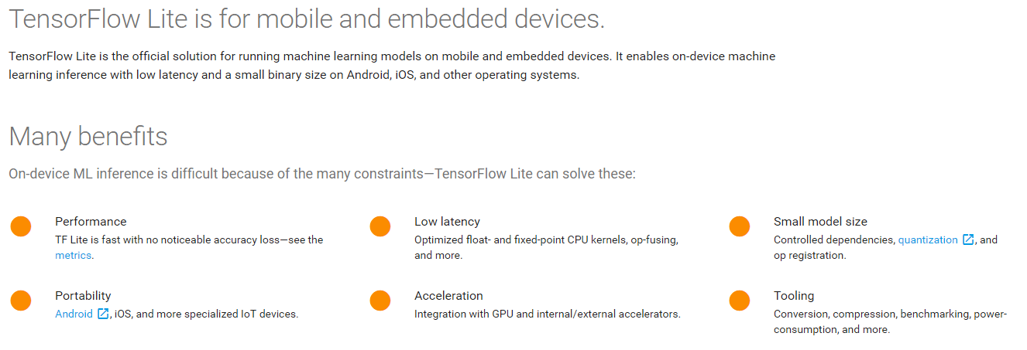
0. Background
0.1 Overview
3/7
Notes:
1. https://tensorflow.google.cn/lite/
2. https://github.com/tensorflow/tensorflow/tree/master/tensorflow/lite

Slide 4
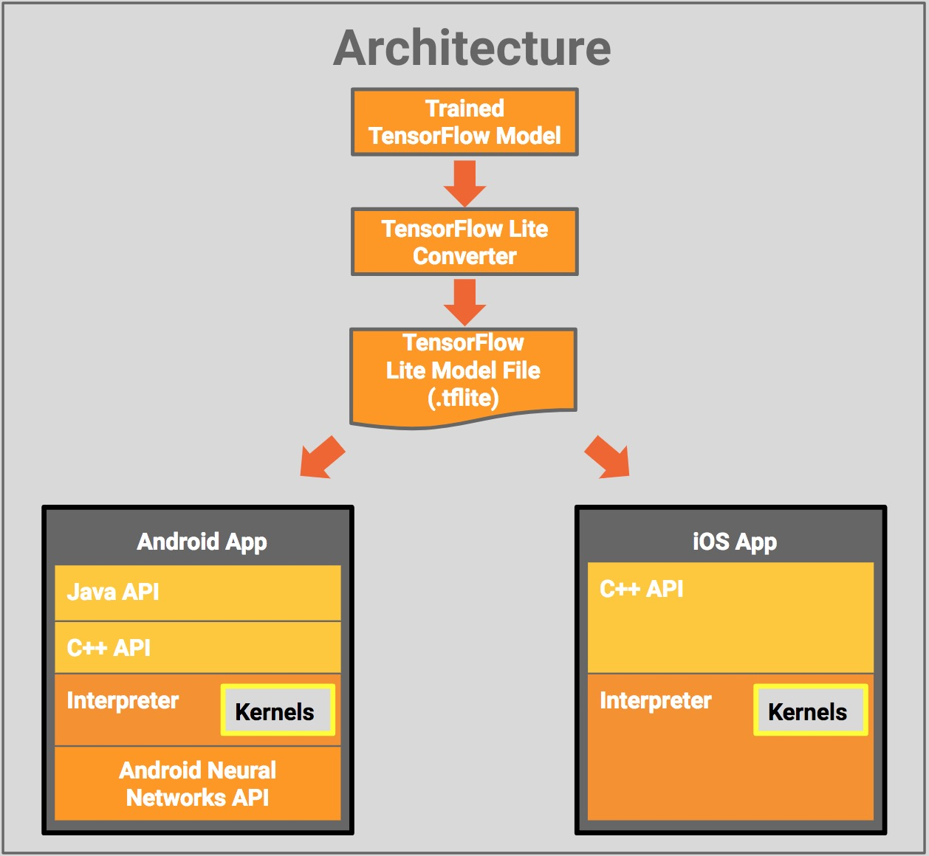
0. Background
0.2 TFLite Architecture
Model file
FlatBuffers.
Interpreter
100Kb
300Kb, kernels load.
Custom kernels.
NNAPI
Hardware acceleration.
4/7
Notes:
1. https://tensorflow.google.cn/lite/
2. https://github.com/tensorflow/tensorflow/tree/master/tensorflow/lite
3. FlatBuffers is an efficient cross platform serialization library for C++, C#, C, Go, Java, JavaScript, Lobster, Lua, TypeScript, PHP, Python, and Rust. It was originally created at Google for game development and other performance-critical applications.

Slide 5
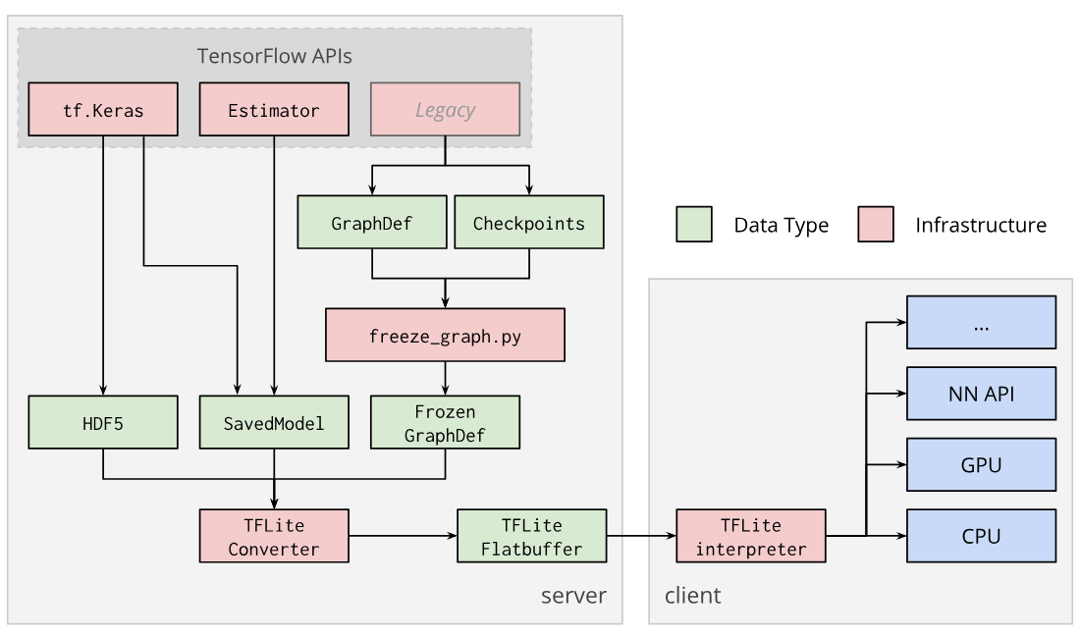
0. Background
0.3 TFLite Converter
GraphDef
Tensor, Ops, Vars def.
.pb, binary.
.pbtxt, readability.
Checkpoints
Serialized vars.
Not interpreted.
Frozen GraphDef
For Inference.
5/7
Notes:
1. https://tensorflow.google.cn/lite/convert/

Slide 6

0. Background
0.4 FlatBuffers
Why FlatBuffers?
Access to serialized data without parsing/unpacking.
Memory efficiency and speed.
Flexible.
Tiny code footprint.
Strongly typed.
Convenient to use.
Cross platform code with no dependencies.
6/7
Notes:
1.FlatBuffers is an efficient cross platform serialization library for C++, C#, C, Go, Java, JavaScript, Lobster, Lua, TypeScript, PHP, Python, and Rust. It was originally created at Google for game development and other performance-critical applications.
2. https://google.github.io/flatbuffers/

Slide 7
0. Background
0.4 FlatBuffers
Supported OS
Windows.
MacOS X.
Linux.
Android.
Others with C++ compiler.
Supported Languages
C, C++, C#
Dart, Go, Lua
Java, JavaScript, TypeScript
Lobster, PHP, Python, Rust …
7/7
Notes:
1.FlatBuffers is an efficient cross platform serialization library for C++, C#, C, Go, Java, JavaScript, Lobster, Lua, TypeScript, PHP, Python, and Rust. It was originally created at Google for game development and other performance-critical applications.
2. https://google.github.io/flatbuffers/

Slide 8
0. Background
0.5 Supported models
Models
Inception_V1, Inception_V2, Inception_V3, Inception_V4.
Mobilenet_V1, Mobilenet_V2.
ResNet_V2, Inception_ResNet_V2.
NASNet mobile/large.
SqueezeNet.
DenseNet.
MnasNet.
8/7
Notes:
1. https://github.com/tensorflow/tensorflow/blob/master/tensorflow/lite/g3doc/models.md

Slide 9
0. Background
0.6 TFLite Benchmark
Model Name | Device | Mean inference time (std dev)
Mobilenet_1.0_224(float) | Pixel 2 | 166.5 ms (2.6 ms)
 | Pixel xl | 122.9 ms (1.8 ms)
Mobilenet_1.0_224 (quant) | Pixel 2 | 69.5 ms (0.9 ms)
 | Pixel xl | 78.9 ms (2.2 ms)
NASNet_mobile | Pixel 2 | 273.8 ms (3.5 ms)
 | Pixel xl | 210.8 ms (4.2 ms)
SqueezeNet | Pixel 2 | 234.0 ms (2.1 ms)
 | Pixel xl | 158.0 ms (2.1 ms)
Inception_ResNet_V2 | Pixel 2 | 2846.0 ms (15.0 ms)
 | Pixel xl | 1973.0 ms (15.0 ms)
Inception_V4 | Pixel 2 | 3180.0 ms (11.7 ms)
 | Pixel xl | 2262.0 ms (21.0 ms)
Device | CPU_MASK
Pixel 2 | f0
Pixel xl | 0c
9/7
Notes:
1. https://tensorflow.google.cn/lite/performance/benchmarks

Slide 10
1. TFLite Demo
Step1. Choose a model.
Step2. Convert the model format.
Step3. Inference in app.
10/7

Slide 11
1. TFLite Demo
1.0 About the Demo
Resize each camera image frame to 224*224(quantized MobileNets) 299*299(Inception-v3).
TFLite Java inference API.
Output, 2-D array.
First, category index.
Second, confidence of classification.
1001 unique categories(background+ImageNet1000).
Top 3.
11/7

Slide 12
1. TFLite Demo
1.1 Three ways TF on Android
Prebuilt binary APK.
Android Studio (IDE).
Recommend
Simplest.
Just want to add TensorFlow to AS.
Bazel, ADB
Custom ops
Build from scratch.
12/7
Notes:
http://download.tensorflow.org/deps/tflite/TfLiteCameraDemo.apk
https://developer.android.com/studio/

Slide 13
1. TFLite Demo
1.2 Preparation
Android5.0 (API 21) or higher.
Model
Quantized MobileNet.
Floating point Inception_v3.
13/7

Slide 14
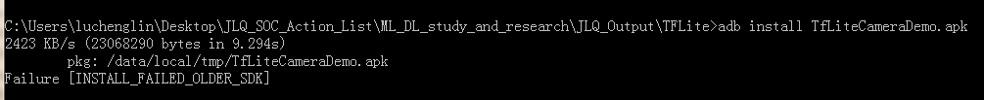
1. TFLite Demo
1.3 Prebuild binary
Download from 1 or 2.
Display
Top three objects classified.
Classification latency.
Devices: LC1860, LC1881.
14/7
Notes:
http://download.tensorflow.org/deps/tflite/TfLiteCameraDemo.apk
https://storage.googleapis.com/download.tensorflow.org/deps/tflite/TfLiteCameraDemo.apk

Slide 15
1. TFLite Demo
1.4 Build the demo using AS
Prerequisites.
Install AS
git clone https://github.com/tensorflow/tensorflow.
Android SDK>26, NDK>14.
Building
Import: tensorflow/lite/java/demo.
Build. mobilenet_quant_v1_224.tflite and labels.txt →/assets
Run → Run 'android'
15/7
Notes:
1. https://developer.android.com/studio/

Slide 16
1. TFLite Demo
1.5 Build from source
Prerequisites.
Install Bazel.
git clone https://github.com/tensorflow/tensorflow.
Android SDK>26, NDK>14, build tools API>26.0.1
Building
WORKSPACE →add SDK NDK path.
bazel build -c opt --cxxopt='--std=c++11' //tensorflow/lite/java/demo/app/src/main:TfLiteCameraDemo
Install
adb install bazel-bin/tensorflow/lite/java/demo/app/src/main/TfLiteCameraDemo.apk
16/7
Notes:
1. https://docs.bazel.build/versions/master/install.html

Slide 17
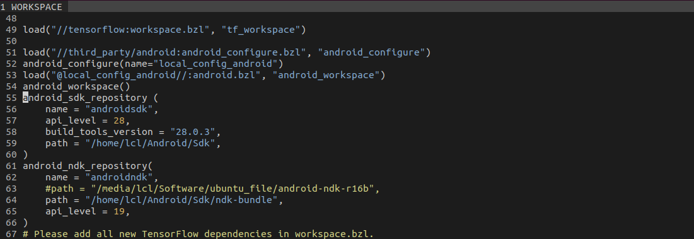
1. TFLite Demo
1.6 Test on Ubuntu18.04
WORKSPACE
17/7

Slide 18
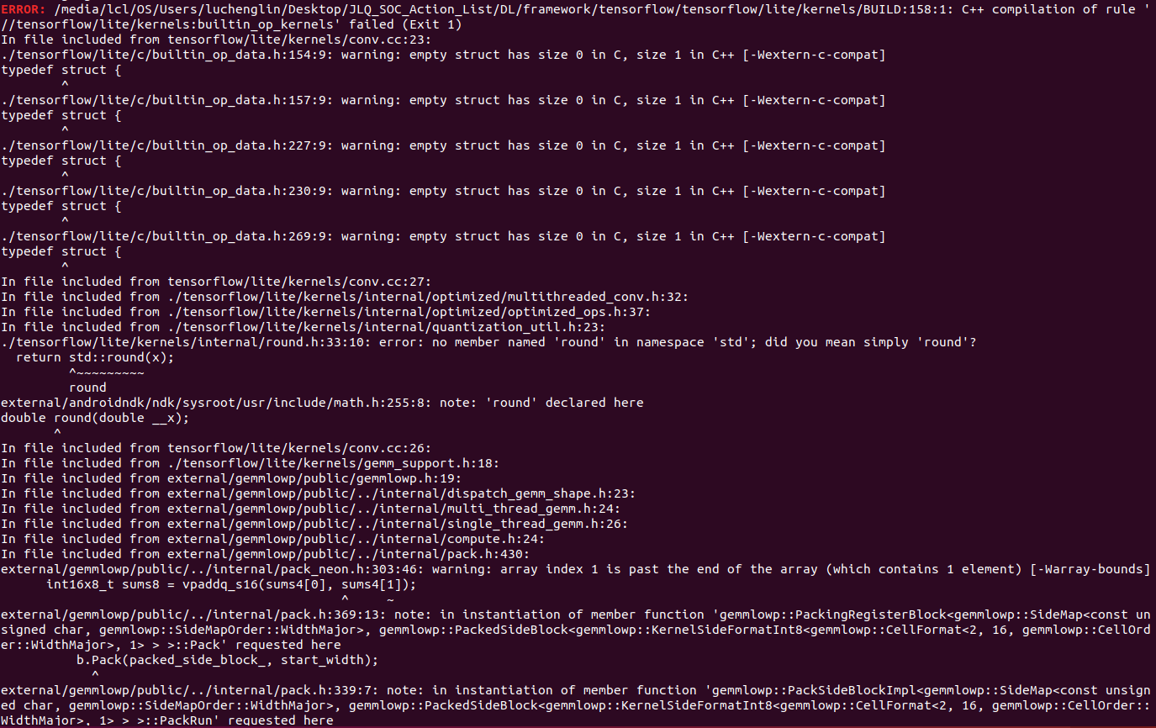
1. TFLite Demo
1.6 Test on Ubuntu18.04
NDK r16b (Error)
18/7

Slide 19
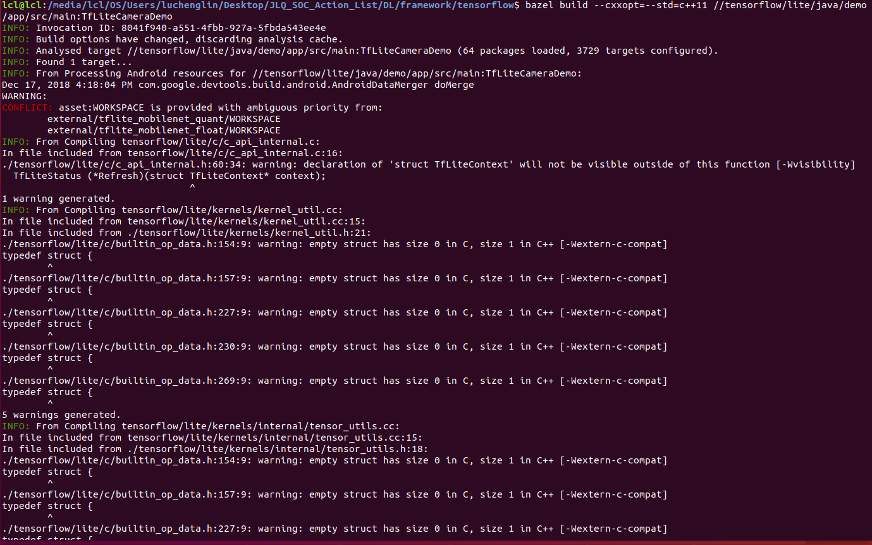
1. TFLite Demo
1.6 Test on Ubuntu18.04
NDK r18b
19/7

Slide 20
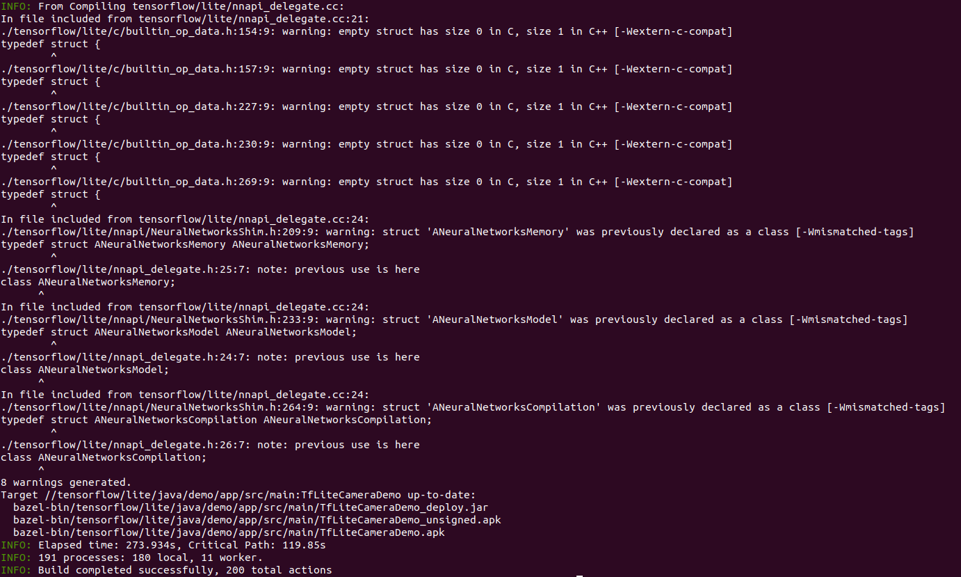
1. TFLite Demo
1.6 Test on Ubuntu18.04
NDK r18b
20/7

Slide 21
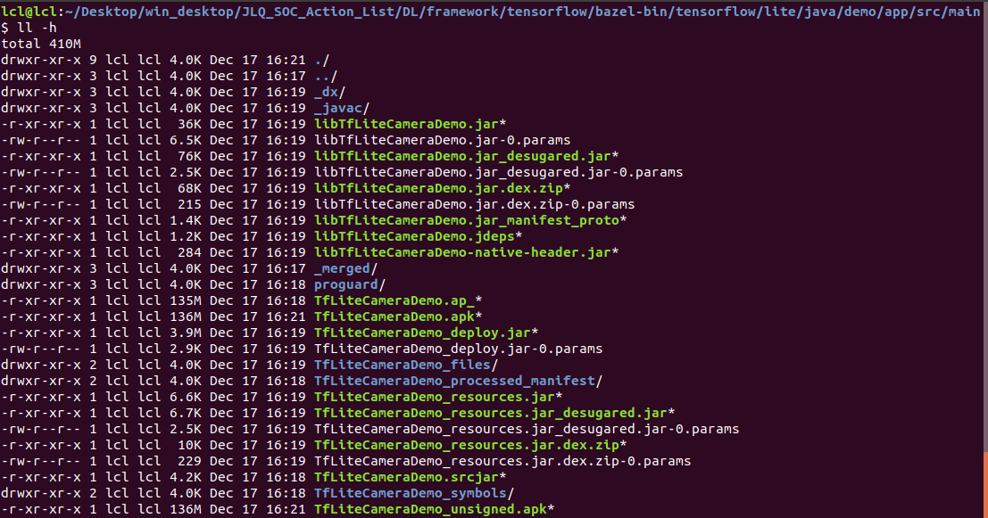
1. TFLite Demo
1.6 Test on Ubuntu18.04
21/7

Slide 22
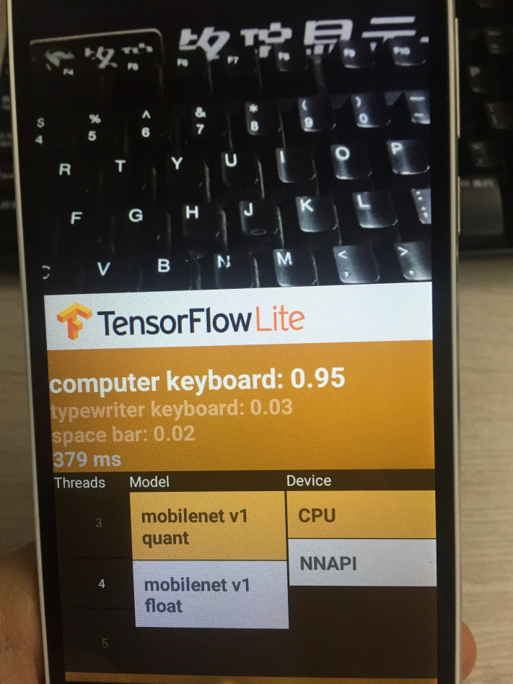
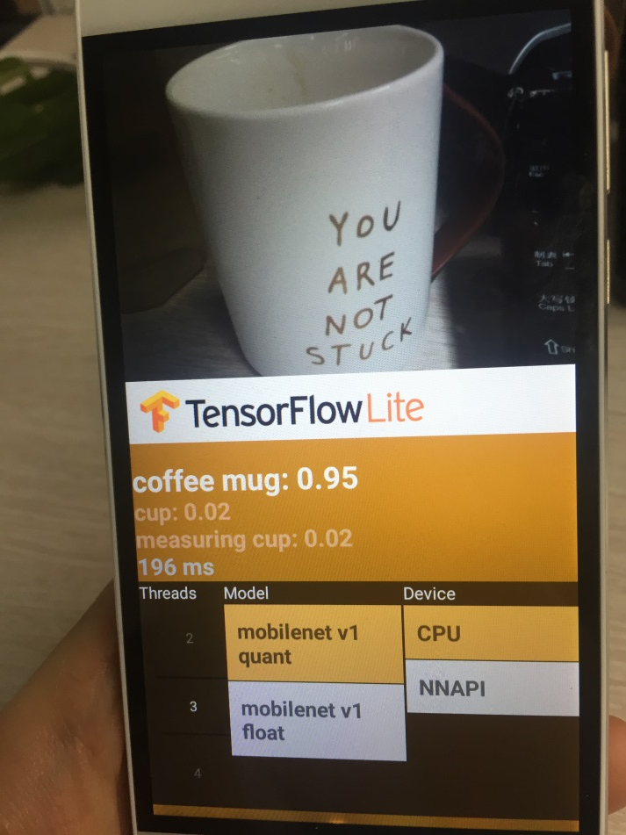
1. TFLite Demo
1.6 Test on Ubuntu18.04
22/7

Slide 23
2. Conclusions
Core ops and custom ops.
Lightweight. All supported ops smaller than 300kb.
Java and C++ API supported.
Better performance ratio.
Low latency and small binary size.
Hardware acceleration. Android NNAPI.
23/7

Slide 24
Thank you

